Slide 1
EENG 284 Lab 10
Stopwatch Control Unit
Notes:
Usually the <title of the lab> is what will be called the “System” through the rest of this document

Slide 2

Taking Llab Assistant Applications
The EENG 284 lab assistant position pays 4-hours a week. Responsibilities of a lab assistant include:
Attending a 4-hour EE Lab Assistant training event at the start of the term,
Working with another undergraduate lab assistant to run the lab. This includes helping students:
Troubleshoot circuits,
Interpreting lab instructions,
Configuring test and measurement equipment
Working with the software
Introducing the lab at the start of the class,
Grading the weekly lab deliverables and entering the grades in Canvas,
Spending 30 minutes reviewing the lab materials,
Meeting 30 minutes a week with the course instructor to review the lab.
This is a great way to both learn the materials and develop teamwork, leadership
and communication skills.

Slide 3
Lab Objectives
Design a FSM in Verilog to control the stopwatch datapath created so that it can keep track of time in run and lap mode.
Lab 8 - Mod10 Counter
Lab 9 - Stop Watch Datapath
Lab 10 - Stopwatch Control Unit
Lab 11 - Stopwatch

Slide 4
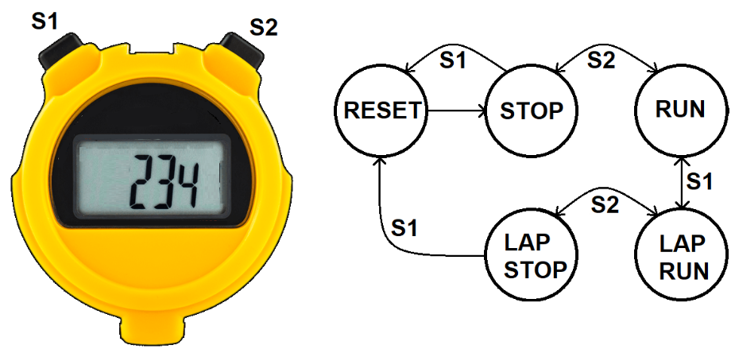
Stopwatch
Measure time down to a 1/10th of a second
Three digit display:
tenths of a second, unit second and tens of seconds
Measuring time intervals from 0.1 to 99.9 sec
Two buttons S1 and S2 determine behavior
Notes:
Replace <System> with the name of the

Slide 5
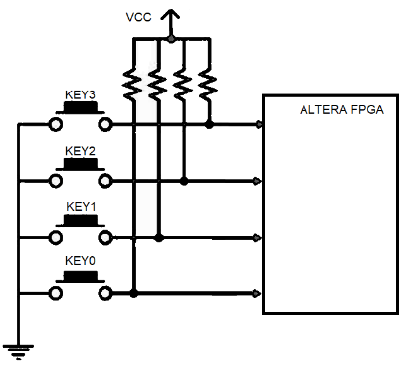
Buttons
The buttons shown are in their nominal position – not pressed.
Not pressed
FPGA input connected to VCC (through resistor)
FPGA input = logic 1
Pressed
FPGA input connected to GND
FPGA input = logic 0
Resistor prevents short; VCC to GND
Notes:
Replace <System> with the name of the

Slide 6
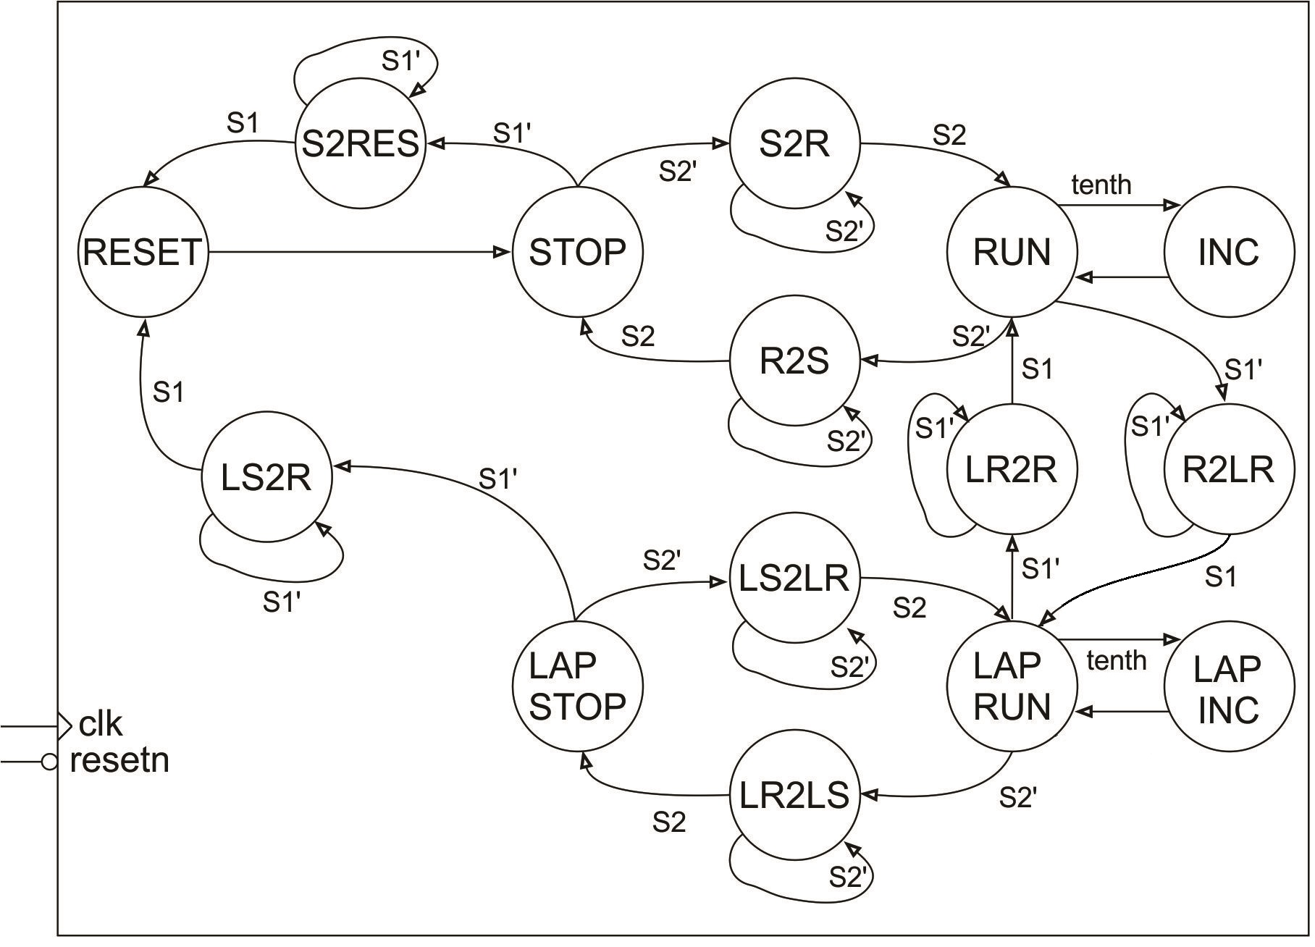
Control Unit
The CU account for the time the user holds the button down.
2 in name stands for “to”
R2S stands for Run to Stop
Find next state for:
Run and S2 pressed
LR2LS and S2 released
Notes:
Replace <System> with the name of the

Slide 7
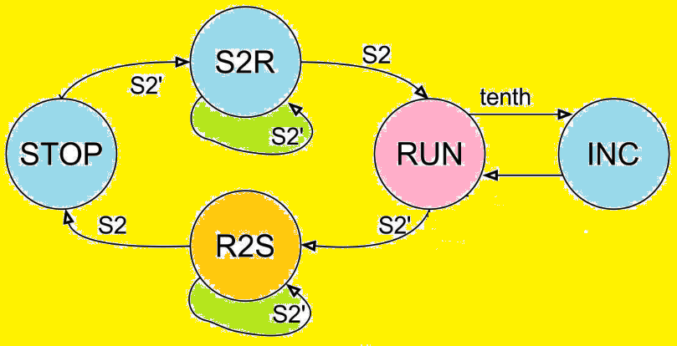
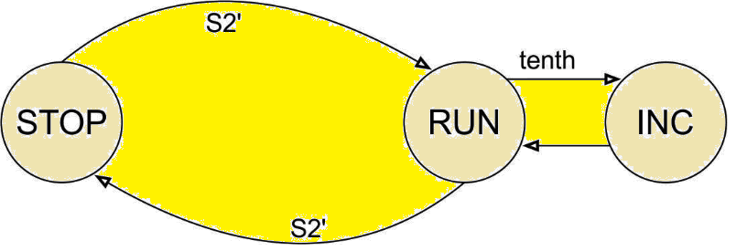
Bad Control Unit
The “2” states allow the button to be held down
In STOP state, press S2 for 0.1 seconds
Incorrect bounces between STOP and RUN 5 million times.
Correct holds up in S2R for 0.1 seconds
Incorrect Correct
Notes:
Talk about the input is transformed into the output using the system architecture

Slide 8
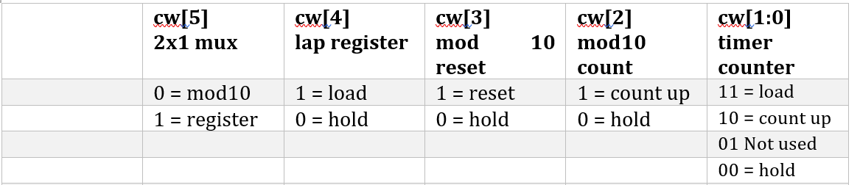
Control Word Table
Two rules
1) Assign the cw[5] bit in the “2” states the cw[5] value used in the destination state. So for example in the RUN2LAP state, set cw[5] to 1 because the cw[5] value in the destination state, LAP
2) Only have the timer counter counting up while the control unit is in the RUN or LAPRUN states. We don’t want the timer counting up in intermediate states because these states do not have an “INC” associated with them, and as a consequence, the tenth pulse from the timer counter would most likely be missed.

Slide 9
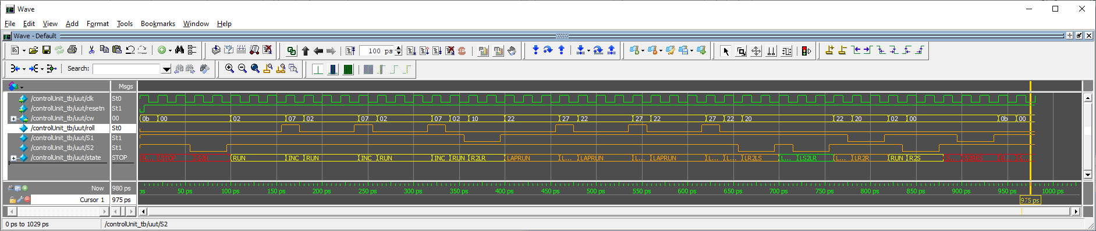
Deliverables
Complete Table 1, and Figures 6-9.
Verilog code for the body of the CU module.
Control Unit Simulation: Produce a timing diagram with specific characteristics. Demonstrate your simulation and your do file works in ModelSim.

